Slide 1
ASSIGNMENT 1 Name :Samir kumar Roll no. 19155086(AE) Mine practice
List various types of equipments used in open cast and uderground operations separately with figure.

Slide 2
*equipment used in 1.open cast 2.uderground operations
equipment
contents
1. List of equipment used in open cast
1.1 Dragline excavator
1.2 Excavator shovel
1.3 Bucket wheel excavator
1.4 Wheel tractor scrapters
1.5 Bulldozer
1.6 Mining Truck

Slide 3
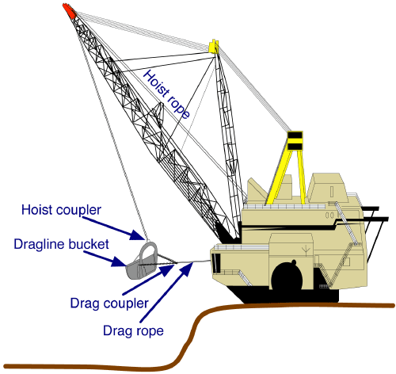
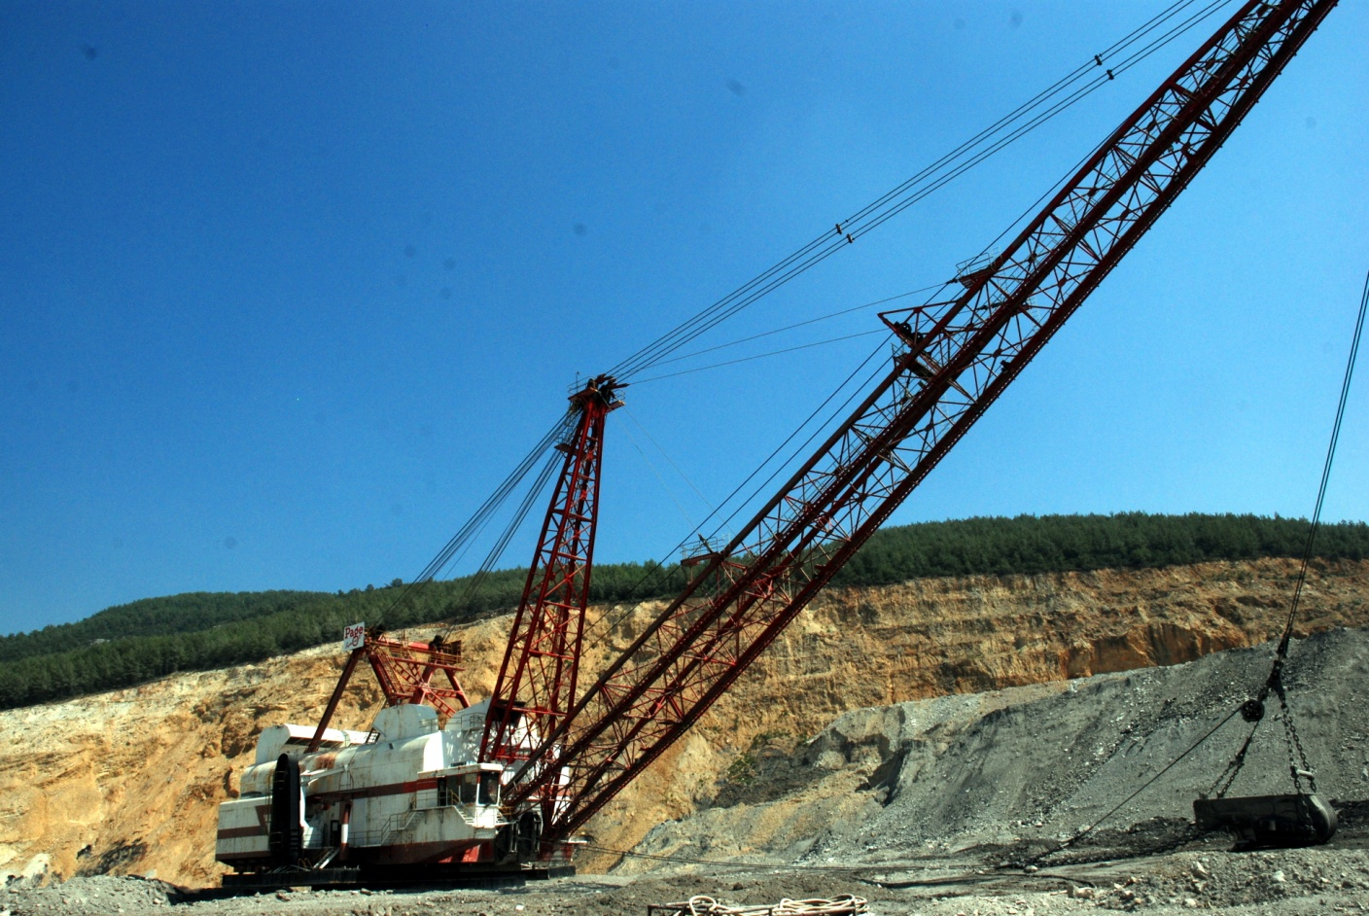
1.1 Dragline Excavator dragline excavator is piece of heavy equipment used in open cast mining . Dragline fall in to broad categories: those that are based on standard ,lifting cranes , and the heavy units which have to be built on site. *working principal of dragline: dragline drops the bucket on the source and then drag it horizontally . Bucket start tilting as it came closer to the machine . Dragline during working can be seen from the animation .
DRAGLINE Excavator

Slide 4
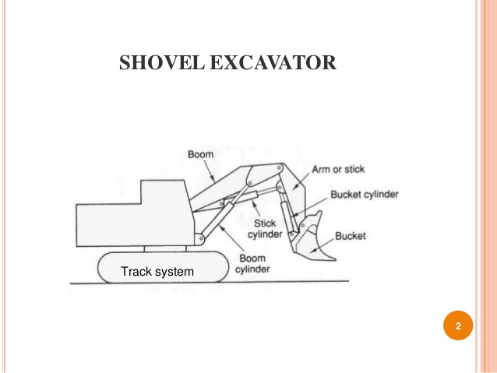
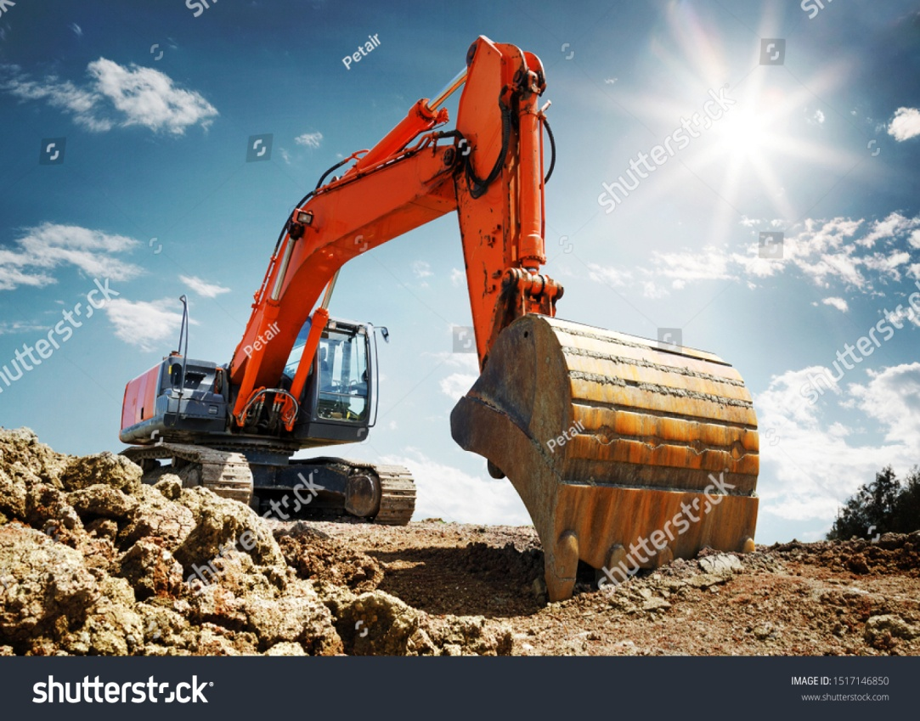
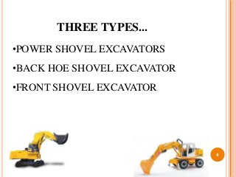
1.2 shovel excavator Excavator shovel or mechanical shovel is a self-propelled machine, on tires or tracks, with a structure capable of rotating at least 360 ° (in one direction and in another, and without interruption) that excavates land, or load, lift, rotate and unloads materials by the action of the spoon, fixed to a set formed by boom and arm or rocker arm, without the supporting structure or chassis moving.
Font shovel excavator

Slide 5
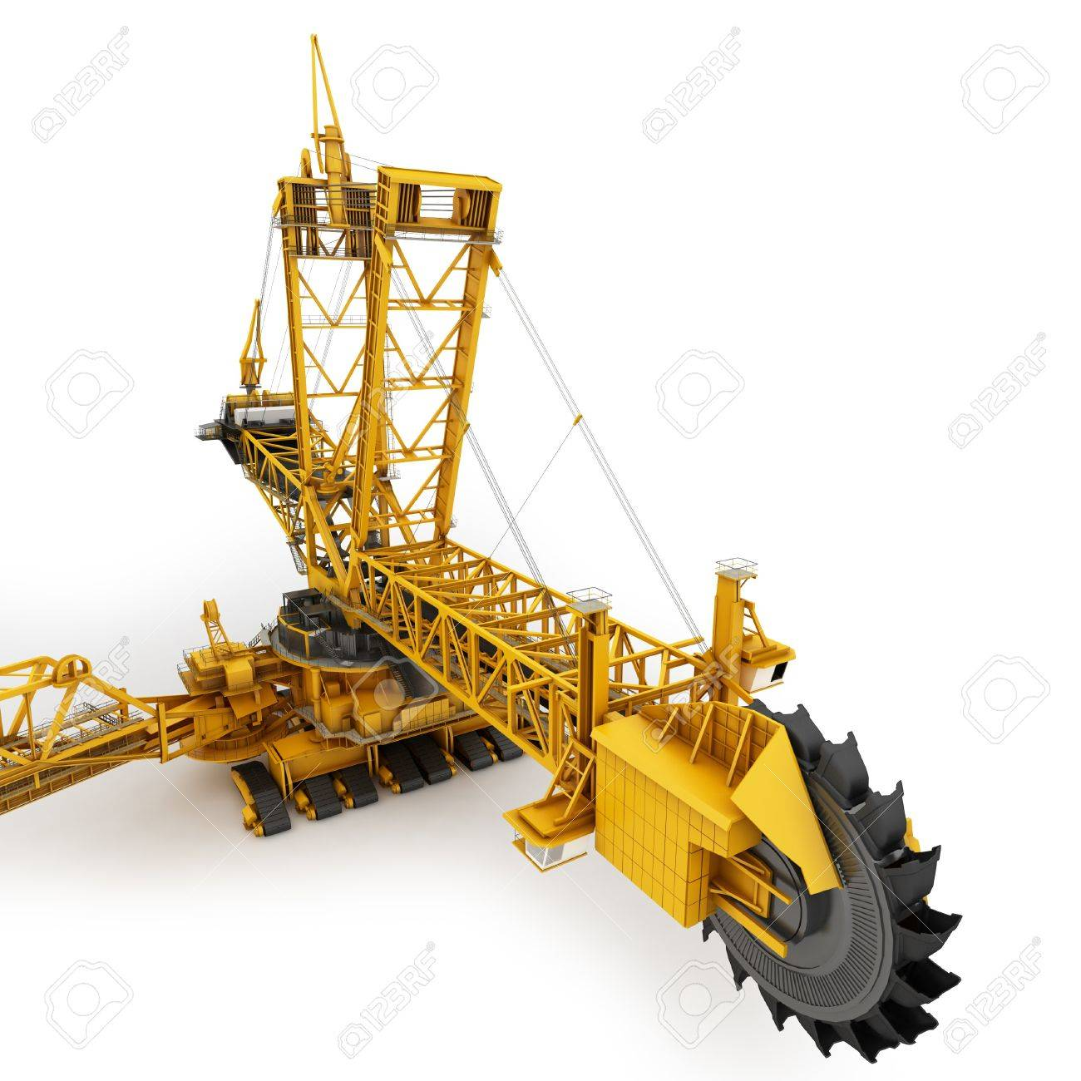
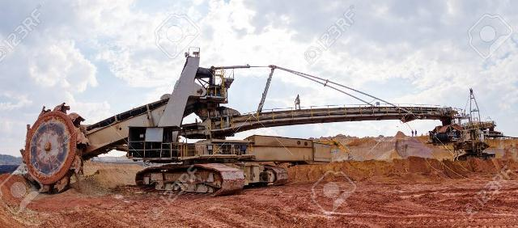
1.3Bucket wheel excavator It is a continuous production machine in which the functions of starting, loading and transport, within it are separated, the first two being made by the impeller and the last by a system of conveyor belts. It can excavate 240,000 tons of coal or 240,000 cubic meters of wastewater per day, the equivalent of a 30-meter-deep soccer field. The coal produced in a day filled 2,400 coal cars.
Bucket wheel excavator

Slide 6
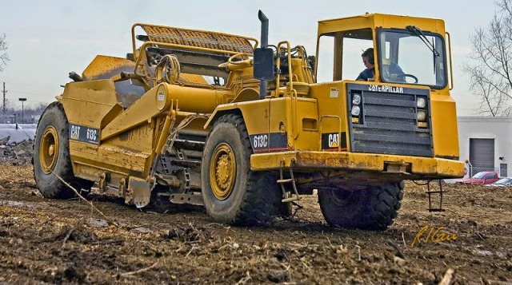
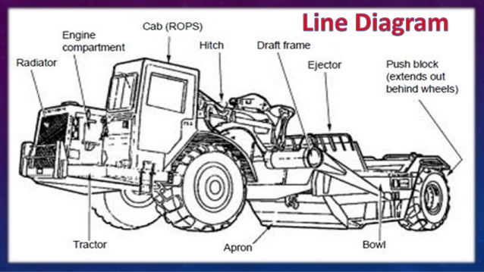
1.4 Wheel tractor scrapers This machine is for transporting earth from one direction to another where it can be seen in the image is not to transport a large amount of land is to carry the specific where it is released by the earth when moving.
Line diagram
Wheel Tractor Scrapers

Slide 7
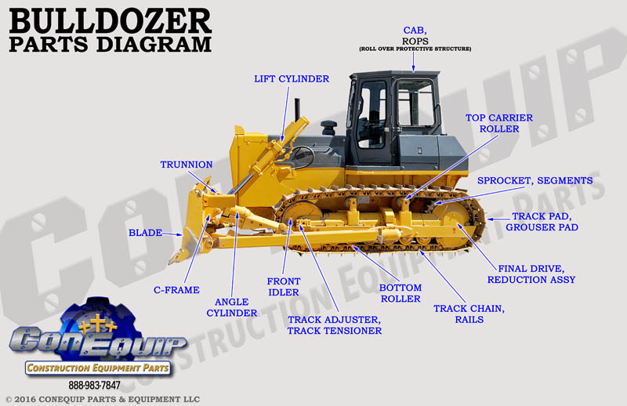
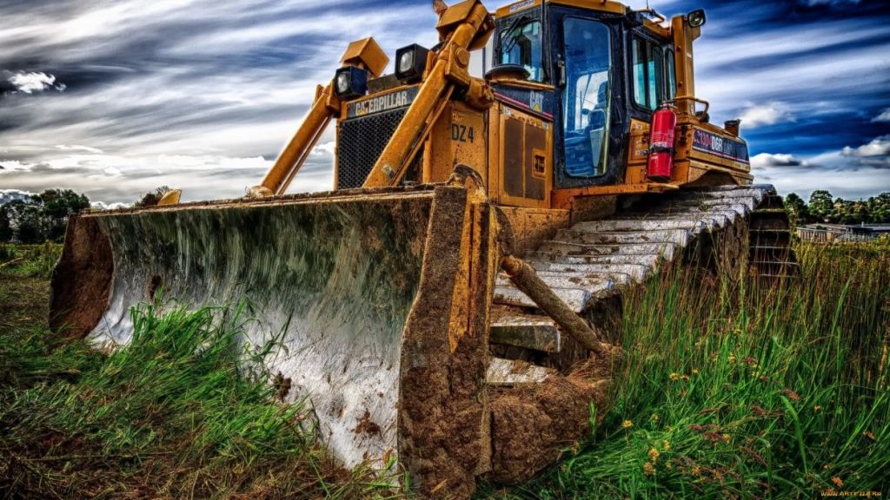
Bulldozer It is a type of bulldozer that is mainly used for earthmoving, digging and pushing other machines. Although the blade allows a vertical movement of elevation, with this machine it is not possible to load materials on trucks or hoppers, so the movement of the earth is done by dragging.
Bulldozer
diagram

Slide 8
*
1.5 Mining Truck
The trucks have been specializing and adopting a series of characteristics of the work to which they are destined in the mines are responsible for transporting the ore and sterile to the dump. In the majority the structure is integrated by a supporting chassis, generally a structural frame, a cabin and a structure to transport the load.

Slide 9
2.Underground Mining equipment Soft rock mines, such as coal, do not require the use of explosives for extraction. These rocks can be cut with the tools provided by modern technology. Soft rocks are also salt, potash, bauxite. In hard rock mines, extraction is carried out by drilling and blasting. First holes are made with compressed air or hydraulic drills. Then holes are inserted into the holes and an explosion is caused to fracture the rock. The blasted rock is loaded into steeply inclined galleries, through which the rock falls into an access shaft. It is loaded into containers called ladles and removed from the mine.
Underground Mining equipment
2.1 mining drill
2.2 underground loader
2.3 crane lift
2.4 Shotcrete machine
2.5 longwall mining

Slide 10
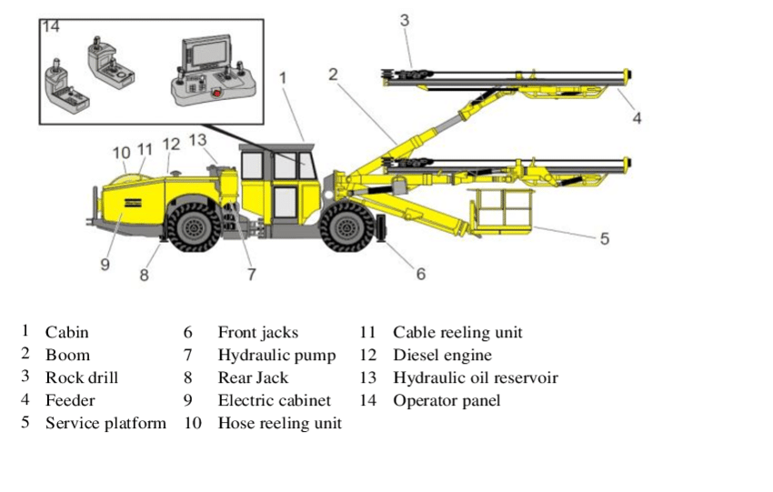
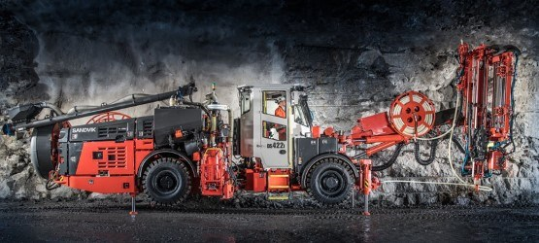
2.1 Mining drill Its technical name is jumbo drilling which the main function of this machine is the drilling of work fronts to subsequently perform the corresponding trimming. This equipment is very effective and reliable which it’s working time is much lower than how it was done in the past, which is why it is of great help for bigger and safer productivity.
Mining drill
diagram

Slide 11
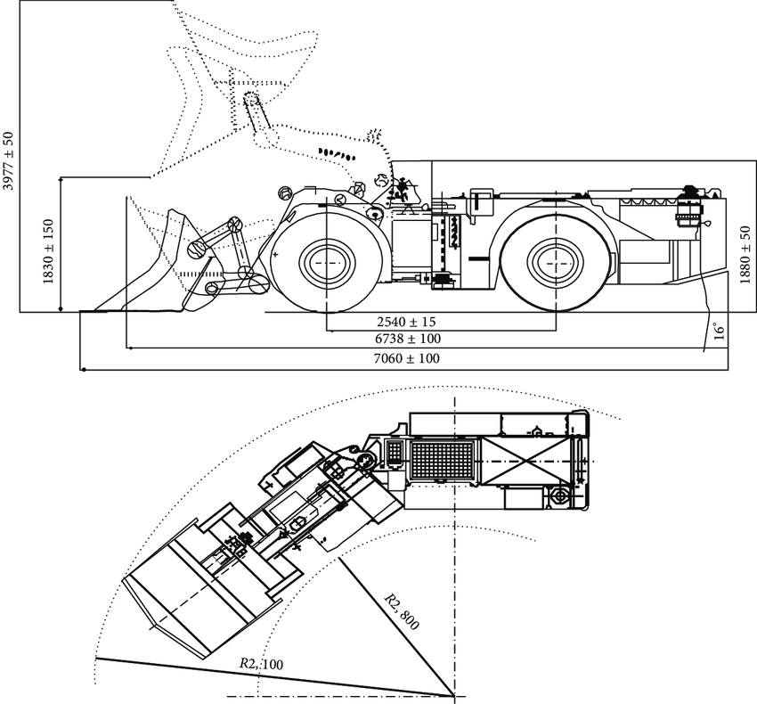
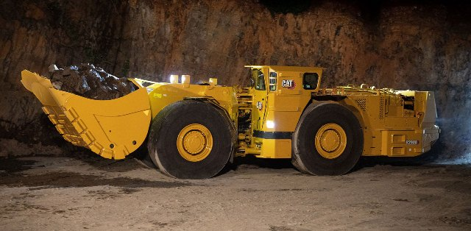
2.2 underground loader The image clearly represents the work of this team called scoop, which is used once the blast has been made on the work front. The work of this team consists of the removal of this material from the forehead to a marine collection point or to emptying pits.
Underground loader
Diagram

Slide 12
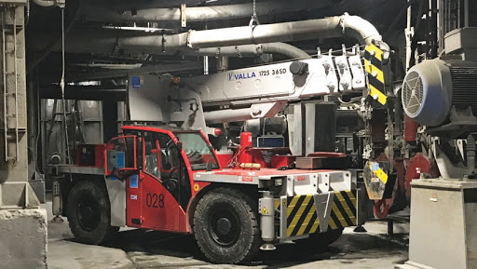
2.3 Crane lift Equipment used to meet the needs of workers in the work fronts, either to perform the loading of explosives as well as the fortification respectively that is carried out at the work front is very useful for the progress of the work that must be done in height
Lifting from below

Slide 13
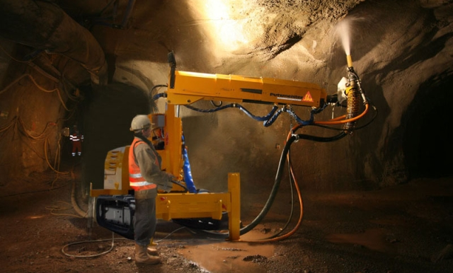
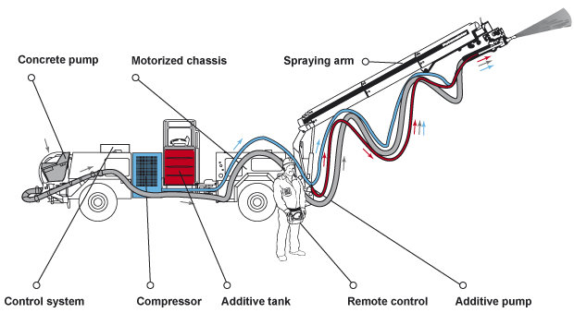
2.4 Shotcrete machine Mechanical equipment used for the projection of shotcrete either wet or dry which facilitates too much the work of the projection of this material giving greater progress and quality to the work to be done
Shotcrete Machine
Diagram

Slide 14
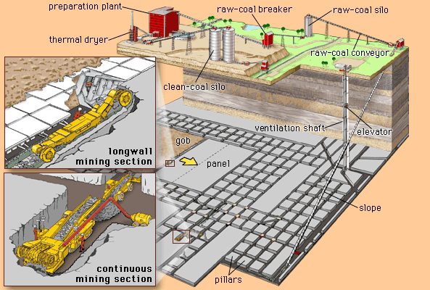
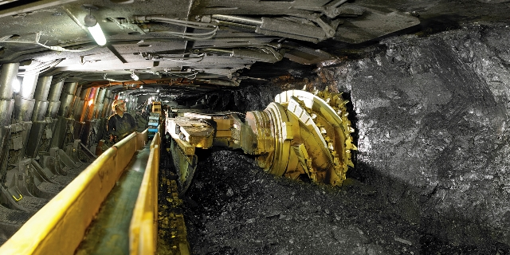
1.5 Longwall Mining The shearing machine is the most used equipment in the construction of tunnels and underground galleries where her head has tips to break the hardest places
Longwall mining
diagram

